Slide 1
Team SmartGrass – SRS and Project Charter Overview 10/20/2014
Belachew Haile-Mariam
Gautam Adhikari
Jeremiah O’Conner
Tung Vo

Slide 2
SRS – Updates and Revisions
Updated SRS to reflect GTA’s notes
Integrated peer review suggestions
Reviewed and removed some requirements the team found unnecessary

Slide 3
SRS – Product Concept
Home Irrigation System (HIS) is designed to offer customers a smart, automated home watering system
The target audience for HIS includes home owners, water conservationists, and anyone interested in optimizing their home irrigation

Slide 4
SRS – Product Description and Functional Overview
With a central microcontroller, systems of soil moisture sensors, and web server, HIS must communicate effectively across all its systems
Major components include microcontroller, soil sensors, web services, remote system control, and water scheduling

Slide 5
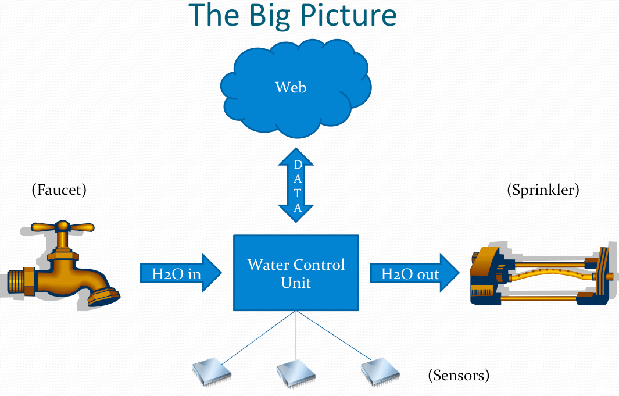
SRS – Product Description and Functional Overview

Slide 6
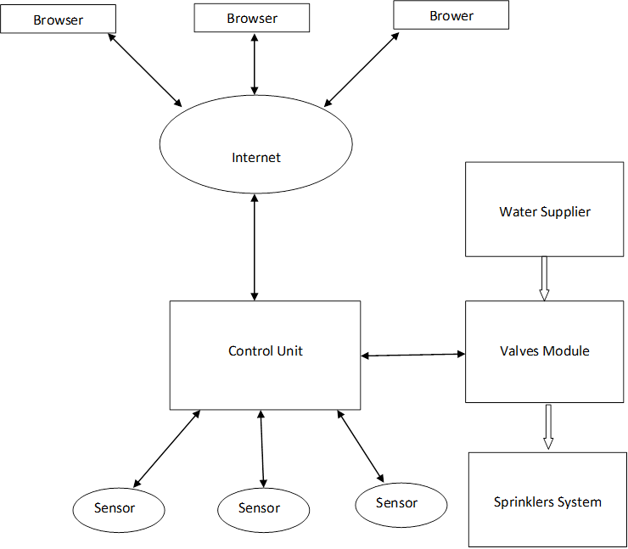
SRS – External Inputs and Outputs

Slide 7
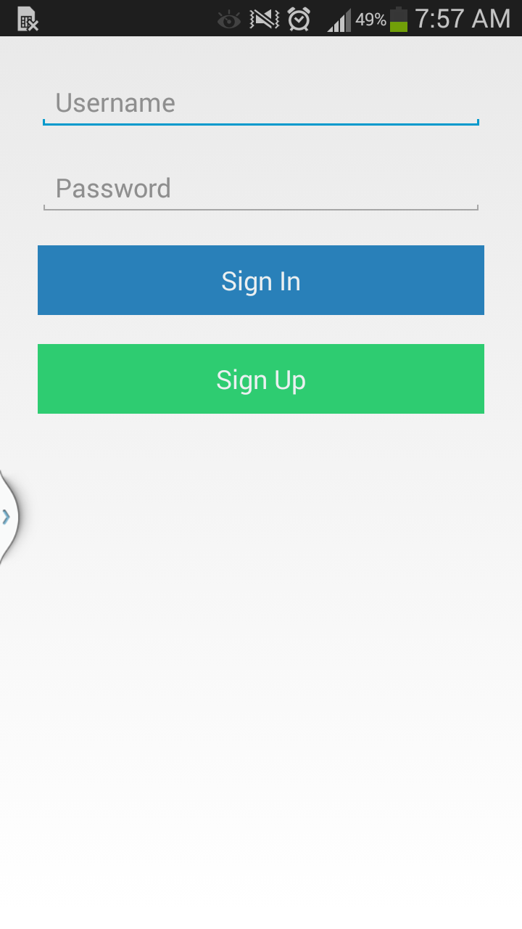
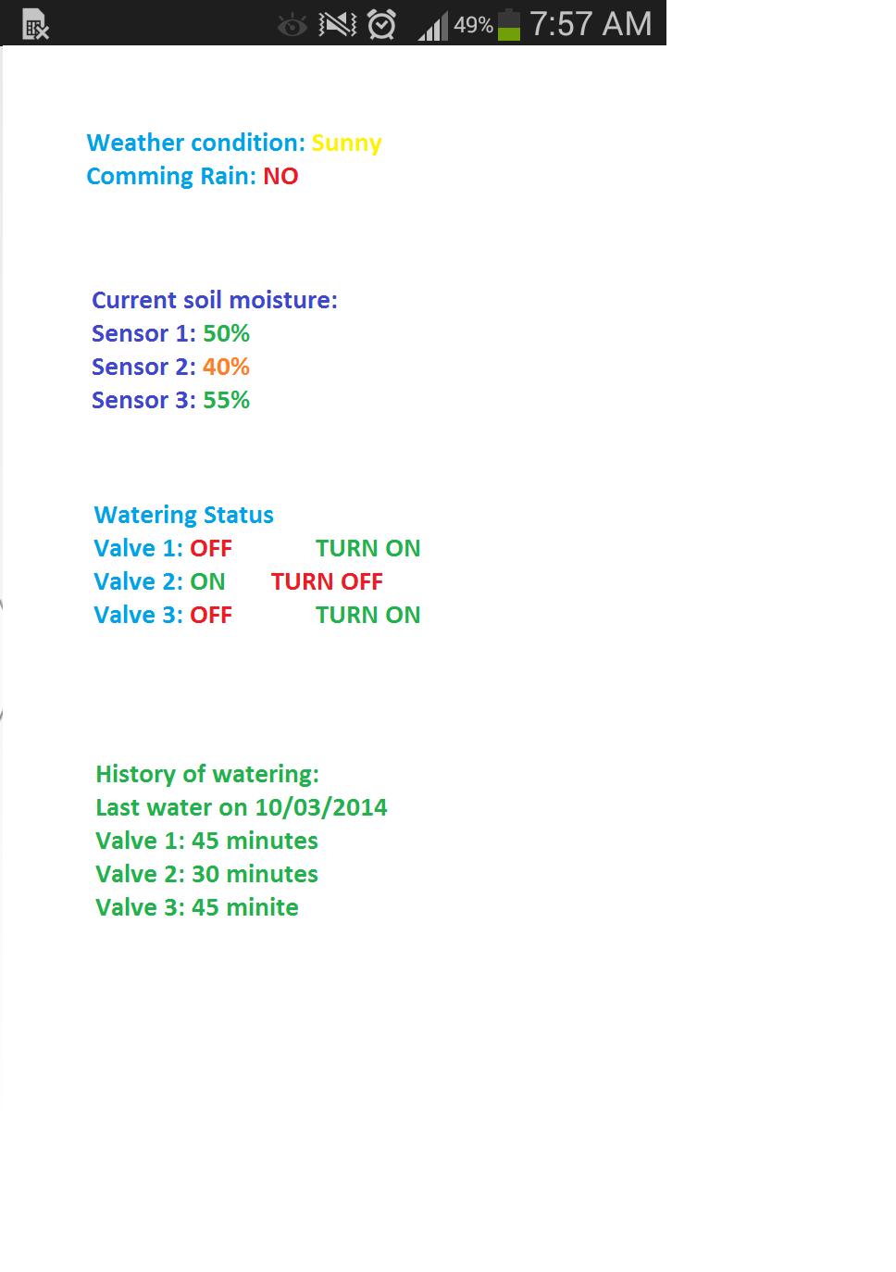
SRS – Product Interfaces

Slide 8
SRS – Customer Requirements
Centralized Control Unit - Responsible for communicating directly with the web server. The control unit will transmit the readings from the soil sensors and report this information to the server
Water Scheduler - The web application can schedule water times and durations for the sprinkler system. The scheduler will display upcoming schedules and allow users to change or delete them

Slide 9
SRS – Performance Requirements
Sensor Accuracy - Proper sensor readings must be captured to ensure accurate reports for watering. This requires adequate reading times and proper analysis of those readings
Local Weather Analysis - Weather readings must be analyzed quickly to ensure watering is not active during rain or a storm

Slide 10
SRS – Safety Requirements
Insulation - Sensor and the control unit use electricity to operate and communicate. These components will not work or probably get destroyed when they come in contact with water. Failure to insulate these components may also result in electric shock and might result in fatal injury

Slide 11
SRS – Other Requirements
Verify User Account
Verify Water Control
Requirement Number | Name
3.5 | Web Application
3.6 | User Administration Account
3.9 | User Login
3.14 | Database Management System
Requirement Number | Name
3.1 | Centralized Control Unit
3.3 | Water Valve
3.4 | Control Unit Case
3.15 | Application Menu

Slide 12
SRS – Use Cases

Slide 13
SRS – Feasibility Assessment
Schedule Analysis
Program Characteristic | Low Complexity | Medium Complexity | High Complexity | Totals
Number of Inputs | 4 x 3 | 1 x 4 | 2 x 6 | 28
Number of Outputs | 3 x 4 | 2 x 5 | 1 x 7 | 29
Inquiries | 3 x 3 | 0 x 4 | 1 x 6 | 15
Logical Internal Files | 3 x 7 | 3 x 10 | 0 x 15 | 51
External Interface Files | 2 x 5 | 4 x 7 | 2 x 10 | 58
Unadjusted Function-Point Total |  |  |  | 181
General System Characteristics | Priority Rating (0-5)
Data Communications | 5
Distributed Data Processing | 3
Performance | 5
Heavily Used Configuration | 2
Transaction Rate | 4
On-Line Data Entry | 3
End-User Efficiency | 4
On-Line Update | 0
Complex Processing | 4
Reusability | 1
Installation Ease | 3
Operational Ease | 3
Multiple Sites | 1
Facilitate Change | 2
Total | 40
Influence Factor | 1.05

Slide 14
Project Charter – General Organization
Team Member | Role | Responsibility
Belachew Haile-Mariam | Project Manager Hardware Lead | - Manage Project Plan - Delegate Tasks - Hardware Integration
Gautam Adhikari | Risk Manager Application Developer | - Notify team of possible risks - Aid in software tasks
Jeremiah O’Connor | Document Master Software Lead | - Document Formatting - In charge of web application development
Tung Vo | Quality Assurance Lead Application Developer | - Perform testing as needed - Aid in hardware tasks
Keith Aholt | Project Sponsor | - Provide feedback relating to project requirements
Mike O’Dell | Project Supervisor | - Oversee project and ensure that we are on track

Slide 15
Project Charter – General Organization
Constraints – limited time, limited budget, limited knowledge, other obligations
Preliminary Schedule and Cost Estimates
Preliminary Project Schedule (Phase I)
Project Milestone | Due Date | Cost (Hours)
SRS First Draft | 10/08/2014 | 75
Project Charter First Draft | 10/15/2014 | 75
Project Plan First Draft | 10/15/2014 | 10
Requirements Gate Review | 11/05/2014 | 50
Architecture Design Specification Draft | 12/01/2014 | 95
Baseline Project Charter | 12/10/2014 | 25
Baseline Project Plan | 12/10/2014 | 25
Architecture Design Gate Review | 12/10/2014 | 50

Slide 16
Project Charter – Scope Statement
Product Definition – The HIS will be a physical device that users will be able to connect to their home sprinkler system to enable smart water and automation through soil sensors
Purpose - To design, implement, and develop a system for users to monitor the watering of their home lawns and gardens

Slide 17
Project Charter – Cost Management Plan
Cost Breakdown
Part | Cost
Microcontroller(x2) | $70.00
LCD Screen | $149.98
Moisture Sensors(x4) | $9.95
Water Valve(x2) | $30.00
Hosting service(x5) | $20.00
Water Hose(x2) | $20.00
House & Grass Model | $50.00
Miscellaneous | $100.00
Total Cost: | $629.78

Slide 18
Project Charter – Scope Management Plan
Definition - The project scope has been defined by a set of requirements established by the team and sponsor. These requirements cover each individual component that make up the project scope
Management - In order to maintain and manage scope effectively each individual team member is responsible for monitoring each task as they are set forth and worked on

Slide 19
Project Charter – Work Breakdown Schedule
WBS | Task Name | % Complete | Duration | Start | Finish
1 | Phase I | 46% | 69 days | Fri 9/5/14 | Wed 12/10/14
1.1 | Project Startup | 100% | 5.25 days | Fri 9/5/14 | Fri 9/12/14
1.1.1 | Define Project Identity | 100% | 2 hrs | Fri 9/5/14 | Fri 9/5/14
1.1.2 | Setup GroupMe Application | 100% | 0.5 hrs | Fri 9/5/14 | Fri 9/5/14
1.1.3 | Setup GitHub Repository | 100% | 1 hr | Fri 9/5/14 | Fri 9/5/14
1.1.4 | Setup Facebook Group | 100% | 0.5 hrs | Fri 9/5/14 | Fri 9/5/14
1.1.5 | Setup Google Drive | 100% | 1 hr | Fri 9/5/14 | Fri 9/5/14
1.1.6 | Secure Sponsorship | 100% | 0.45 wks | Wed 9/10/14 | Fri 9/12/14
1.1.6.1 | Initiate Sponsor Proposals | 100% | 2 hrs | Wed 9/10/14 | Wed 9/10/14
1.1.6.2 | Setup Sponsor Meeting | 100% | 1 hr | Wed 9/10/14 | Wed 9/10/14
1.1.6.3 | Initiate Sponsor/Team Meeting | 100% | 2 hrs | Wed 9/10/14 | Wed 9/10/14
1.2 | MS Project Plan | 42% | 69 days | Fri 9/5/14 | Wed 12/10/14
1.2.1 | Project Plan First Draft | 100% | 29 days | Fri 9/5/14 | Wed 10/15/14
1.2.2 | Project Plan Baseline | 0% | 40 days | Thu 10/16/14 | Wed 12/10/14
1.3 | System Requirements Phase | 56% | 64 days | Fri 9/12/14 | Wed 12/10/14
1.3.1 | Requirements Research | 100% | 5 days | Fri 9/12/14 | Thu 9/18/14
1.3.1.1 | Software Requirements | 100% | 1 wk | Fri 9/12/14 | Thu 9/18/14
1.3.1.2 | Hardware Requirements | 100% | 1 wk | Fri 9/12/14 | Thu 9/18/14
1.3.2 | System Requirements Specification | 62% | 27 days | Wed 10/1/14 | Thu 11/6/14
1.3.2.1 | SRS First Draft | 97% | 19 days | Wed 10/1/14 | Mon 10/27/14
1.3.2.2 | SRS Baseline | 0% | 21 days | Thu 10/9/14 | Thu 11/6/14
1.3.3 | Project Charter | 44% | 43 days | Mon 10/13/14 | Wed 12/10/14
1.3.3.1 | Project Charter First Draft | 100% | 3 days | Mon 10/13/14 | Wed 10/15/14
1.3.3.2 | Project Charter Baseline | 0% | 41 days | Wed 10/15/14 | Wed 12/10/14
1.4 | System Architecture Phase | 0% | 25 days | Thu 11/6/14 | Wed 12/10/14
1.4.1 | Architecture Design Specification | 0% | 25 days | Thu 11/6/14 | Wed 12/10/14
2 | Phase II | 0% | 1 day | Tue 10/14/14 | Tue 10/14/14
3 | Weekly Tasks | 0% | 1 day? | Tue 10/14/14 | Tue 10/14/14

Slide 20




Project Charter –Communications Plan
Team Meetings - Our team has two meetings every week. Usually, the meetings last 2 hours on Monday and Tuesday from 1 pm to 3 pm
Internal Communication

Slide 21
Project Charter – Change Management Plan
Roles and Responsibilities
Project Sponsor – Our sponsor, Mr. Aholt, Owner and Manager of Nuts and Bolts, will provide us feedback after reviewing our development process.
Project Manager –Upon any changes suggested by our sponsor or peer review, our project manager, Billy will be the first person to address it. He let us know what changes to be made so that our team can make the changes.
Project Team - Our team will carefully review the pros and cons of the changes that we have been suggested or we have been planning to do.

Slide 22
Project Charter – Risk Management Plan
Risk Analysis
Risk Group | Risk | Probability (%) | Cost (weeks) | Risk Exposure (weeks)
Schedule | Behind on schedule and procrastination | 30 | 2 | .60
Document | Integrating everyone’s documents | 10 | 2 | .20
Software | Integrating everyone’s code work | 40 | 4 | 1.6
Hardware | Integrating hardware together | 50 | 4 | 2.0
Technical | Integrating hardware and software | 40 | 2 | .8
Technical | Networking using servers | 40 | 2 | .8
Budget | Lack of fund while purchasing right equipment | 5 | 1 | .5
Team | Availability of members for meeting and working to build project | 40 | 2 | .8
Mis comunication | Misunderstanding the idea or work | 20 | 2 | .4
Total |  |  |  | 7.7

Slide 23
Project Charter – Procurement Management Plan
Description of Items/Services to be Acquired
(2) Microcontroller (Arduino, Raspberry Pi)
(2) Water valve
(4) Soil sensors
(1) Web hosting service
(2) Water hose
(1) Waterproof case for the microcontroller
(1) Digital temperature gauge

Slide 24
Project Charter – Project Closeout Report
Archiving Project Artifacts
Systems Specification Requirement
Project Charter
Purchase Orders
Architecture Design Specification
MS Project Plan File
Team Status Reports
Team Presentations
Detailed Design Document
System Test Plan
Prototype Diagrams
Team and Sponsor Contact Info

Slide 25
Any Questions?

